Slide 1



Slide 2

Welcome – Karakia
Tūtawa mai i runga,
Tūtawa mai i raro,
Tūtawa mai i waho,
Tūtawa mai i roto,
Kia tau ai te mauri tū,
Te mauri ora ki te katoa,
Haumi e hui e TĀIKI E!

Slide 3
Agenda Welcome - Karakia Our purpose and what we offer Natalie Vincent, CEO How we work with Financial Mentors Linda McCallum How we manage the application process Emilie Dobinson The disbursal process and how we manage repayments Marcela Mingoti Strengthening the financial wellbeing of New Zealanders Irihapeti Edwards What it’s like to work with NTM Jane Gibbin Q & A’s Close - Karakia

Slide 4
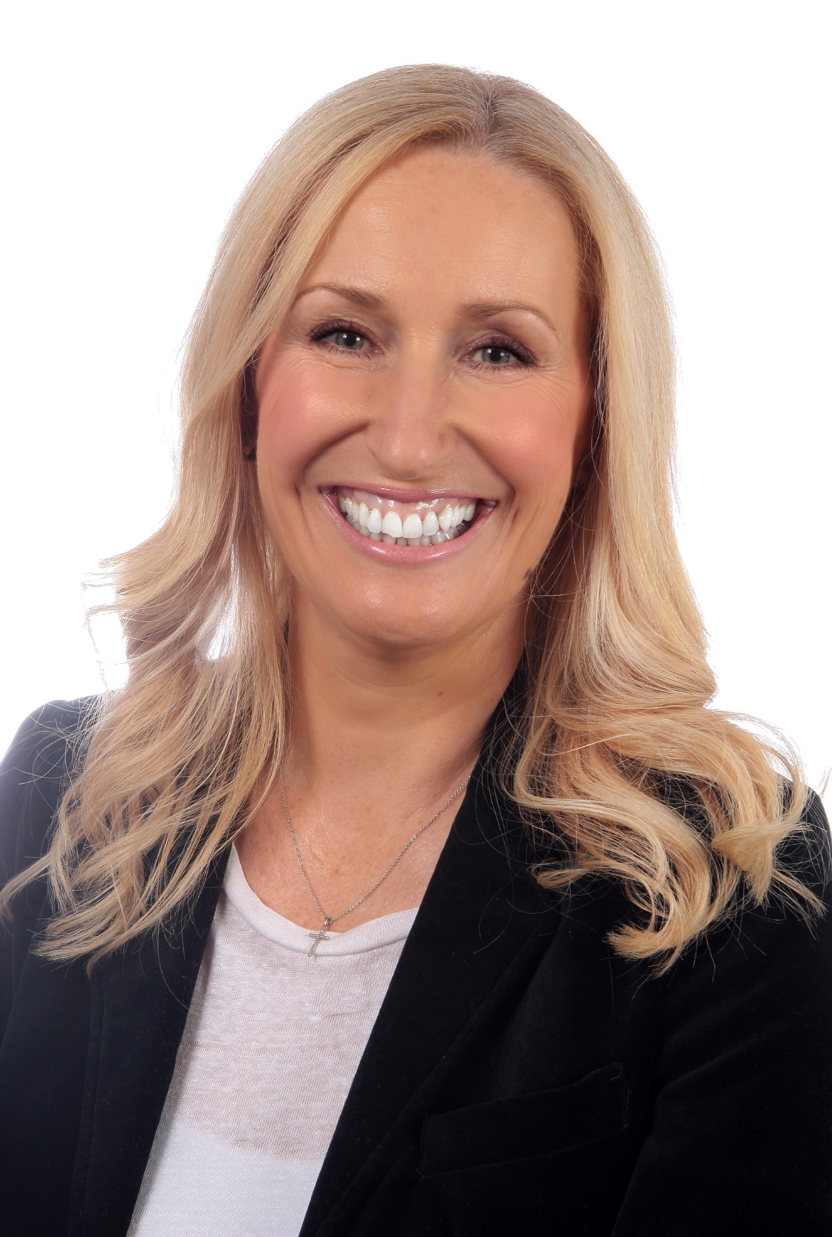
Our Purpose & What We Offer
NATALIE VINCENT CEO
natalievincent@ntm.org.nz
www.linkedin.com/in/natalievincent

Slide 5

Our Purpose
Ngā Tāngata Microfinance is a non-profit organisation providing fee-free and interest-free loans together with financial literacy support to New Zealanders experiencing financial hardship.

Slide 6
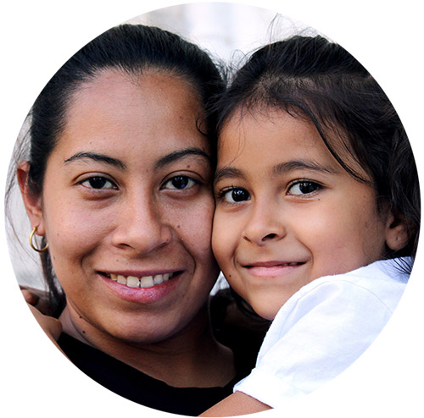
Our Vision
A just and equitable society, with the economic and social inclusion of everyone living in Aotearoa New Zealand, including those on low incomes.
Our Mission To provide safe, fair and affordable finance options that enable financial inclusion and capability, and challenge structural and economic forms of financial exclusion.

Slide 7

How We Help
NTM loans are safe and secure:
✔️ No interest is charged
✔️ No fees are charged
✔️ The loan is repaid over 2 years
✔️ Includes support from a financial mentor
to improve financial capability and wellbeing

Slide 8

The Loans
GetControl
Debt Relief Loan – up to $3,000
GetAhead
Asset Building Loan – Up to $2,000
To pay off high-interest, unmanageable debt
To pay for an essential item such as a fridge, school fees or medical fees (car purchases aren’t covered)
OUR LOANS ARE BACKED BY

Slide 9
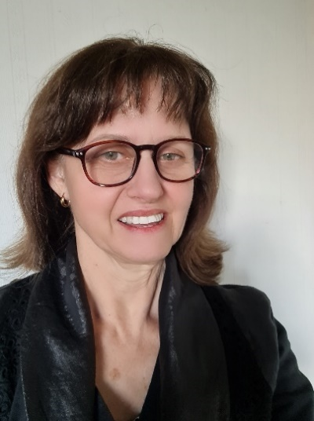
How we work with Financial Mentors
LINDA MCCALLUM Budget Service Engagement Coordinator support@ntm.org.nz

Slide 10
Working with Financial Mentors
Application options
Loan criteria
Preparing an application
Service support

Slide 11
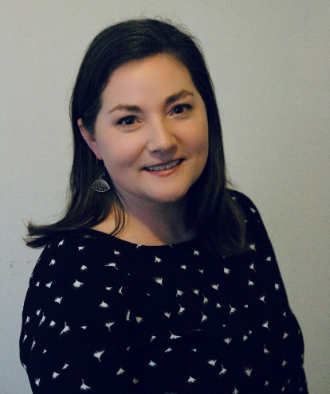
How We Manage the Application Process
EMILIE DOBINSON Loans Officer applications@ntm.org.nz

Slide 12
The Application Process
Receiving an application and supporting documentation
Budgets and debt schedules
Preparing an application for assessment
Application outcome next steps

Slide 13
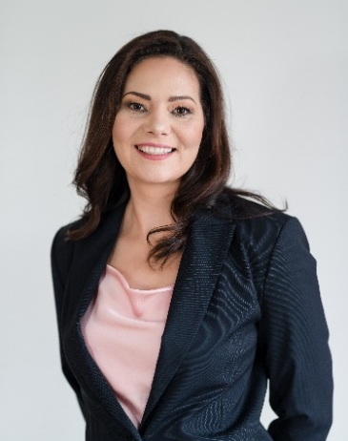
The Disbursal Process and How We Manage Repayments MARCELA MINGOTI Finance Manager finance@ntm.org.nz
www.linkedin.com/in/marcelamingoti

Slide 14
The Disbursal and Repayments Process
How the process works
How the loans are managed
How we manage non-payers
Completed loans and over-payments

Slide 15
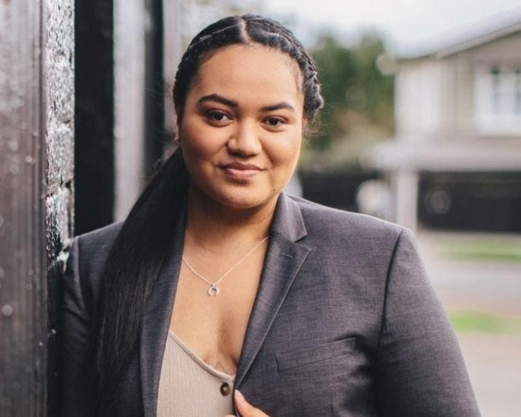
image001 2.jpg
Strengthening the Financial Wellbeing of New Zealanders
IRIHAPETI EDWARDS Financial literacy champion email address
www.linkedin.com/in/iriedwards

Slide 16
Strengthening Financial Wellbeing
My story
Financial literacy skills and their importance
Youth perspective

Slide 17
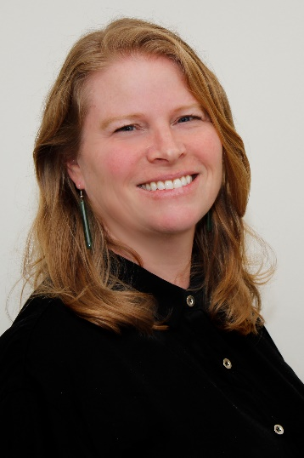
Outcomes for Clients
JANE GIBBIN Financial Mentor budget.mfsc@xtra.co.nz

Slide 18
Working with NTM
The impact of the loans
Settlement with creditors
Advocacy and referrals

Slide 19
Please Keep in Touch
Join our closed Facebook group for Financial Mentors
Follow us on Facebook.com/ngatangatamicrofinance
Follow us on Instagram @nga_tangata_microfinance
Connect on linkedin.com/company/ngā-tāngata-microfinance
Find us on YouTube Ngā Tāngata Microfinance https://www.youtube.com/channel/UCUftPTv_p6qWCqUTDcH8Xtg
www.ngatangatamicrofinance.org.nz

Slide 20
Questions & Answers

Slide 21
Closing – Karakia
Ka whakairia te tapu,
Kia watea ai te ara,
Kia tūruki whakataha ai,
Kia tūruki whakataha ai,
Hui e Tāiki e

Slide 22
Ngā mihi

